Slide 1
Zombono: Replumbing Old Technologies for Modern Experiences
March 29, 2024, Connor Hyde

Slide 2
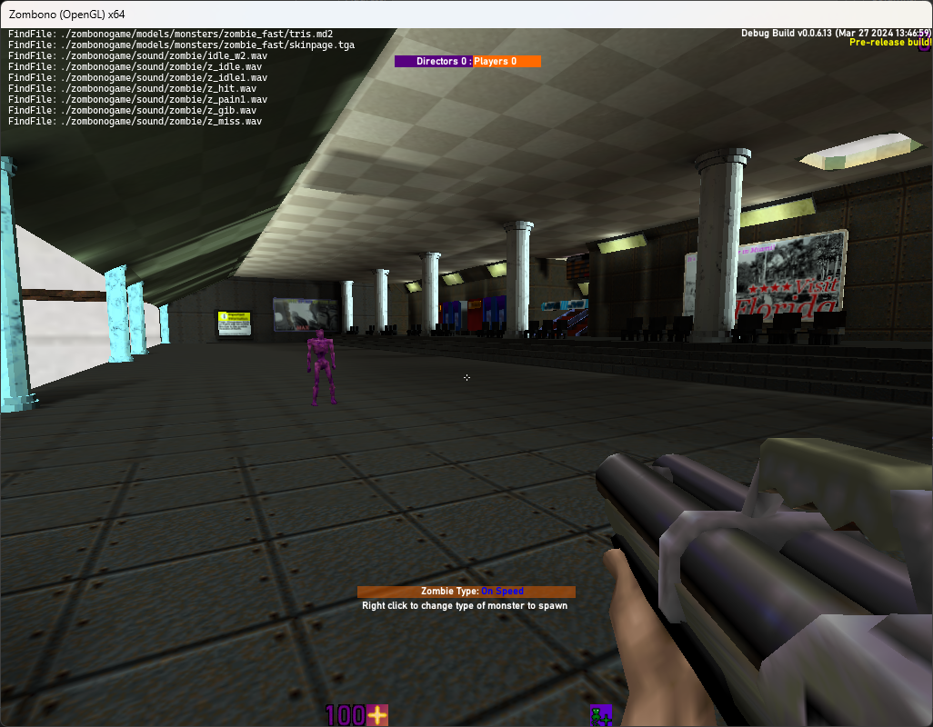
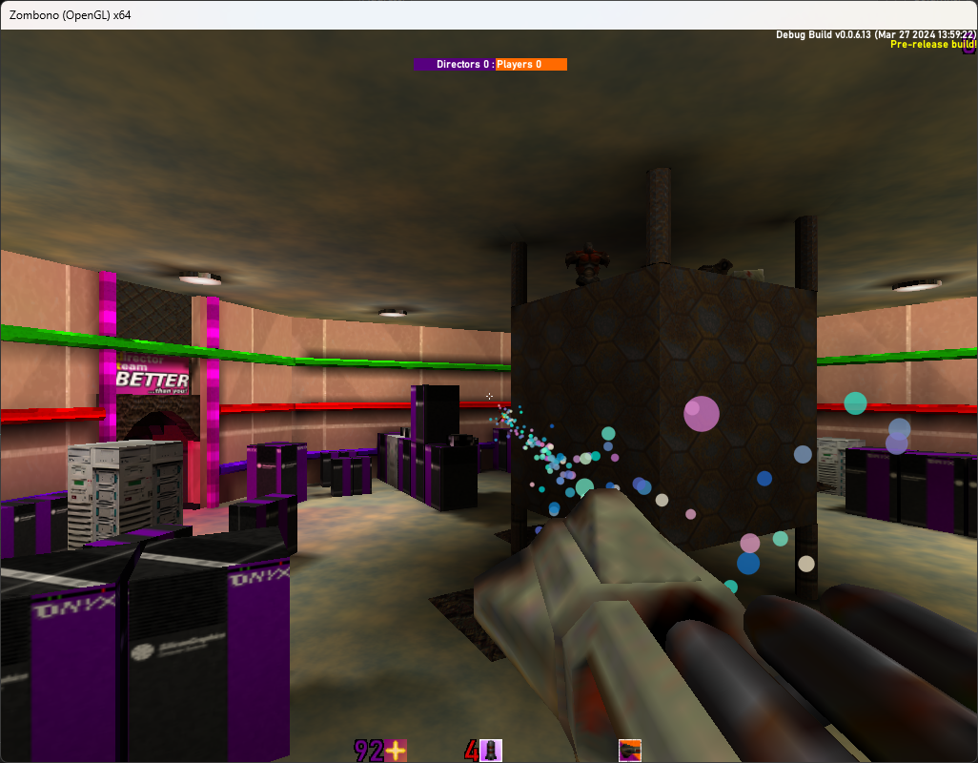
What is Zombono?
Multiplayer team-based FPS
Think L4D2’s Directors x an old boomer shooter like Quake or Unreal Tournament
Two teams
Directors: Entire focus is on spawning various monsters (zombies, zombies on speed, ogres…), special abilities to place in obstructions and also zombify players (need a counter to this)
Players: Somewhat traditional FPS weapons, although the focus is on speed and firepower as opposed to numbers (since you can spawn arbitrary numbers of enemies)
Several modes planned
TDM (only one implemented currently), Co-op (8 level campaign), control point, tournament, hostage, waves, maybe more eventually planned
Engine:
100% C…highly modified, modernised sourceport of classic Quake2
Now the question: Why make this choice?

Slide 3
Why such an old and strange choice of engine?
The game has a 90s boomer shooter aesthetic
Which the old engine obviously fits well with
Very well designed (see next slide)
100% modular, with modules within those modules. Carmack and co. are a bit overblown, but he could at least write a very nice game engine
Provides total control of everything – you are accountable for everything down to the memory allocation and the interaction with the operating system of your chosen platforms (currently Windows and Linux)
Advantages: If a Unity/Unreal/Godot… bug screws you over, you are screwed. Not here…
Disadvantages: Far more code to maintain…that’s the fun part for me though! Maybe I’m a masochist…
Highly documented
100% modular, with modules within those modules
Already used a pre-modernised sourceport (vkQuake2) with many changes…such as Vulkan rendering

Slide 4
Engine Architecture

Slide 5
Engine overview: Modernisation
Based on vkquake2 (https://github.com/kondrak/vkQuake2) – based on principles of modernisation while keeping as much as possible
Cut many things targeted at old, late 90s hardware
Software renderer (even a bargain bin laptop from 10 years ago can run the game)
3dfx Voodoo, Rendition, etc GPU support
Alpha AXP, PowerPC, other dead CPU architectures…
Dead operating systems, like SunOS, IRIX…
Optimisations for dialup modem (how did anyone play online at 33.6K…)
Horrendous proprietary video format (wave files with delta compressed PCX images…WHAT)
Windows 95 specific code
Textures changed to 32-bit colour TGA (support already in engine) from 8-bit PCX
Etc etc etc…

Slide 6
Engine overview: Rendering
Original engine had software, OpenGL 1, and the sourceport added Vulkan
Let’s use Vulkan only since the sourceport uses Vulkan…
…Vulkan renderer is a hacked up OpenGL 1.x renderer. WTF?
Actually don’t know Vulkan
Can’t take that long to learn…
Oh
Okay, let’s actually write an OpenGL 3 renderer, and in the meantime, modernise and fix the OpenGL 1 renderer
Broken alpha function…Apparently 0 and 0.666 are the same thing. What?
More colour support
Rendering areas of textures
Other bugfixes
Custom OpenGL bindings (“Qgl”)…GLAD didn’t exist yet. Replace them with GLAD.
GL3 renderer will be completely new codebase
Nothing from old renderer

Slide 7
Engine overview (cont.)
Completely replaced UI system
New set of controls
Can be customised from files by a mod developer instead of being hardcoded in the engine and sent as strings over the network (WTF?)
Text completely rewritten
N fonts, N font styles, N glyphs, N
Image fonts combined with Json files for recognition (used open source JSON library for this)
Quake 3 colour codes with custom extensions
Protocol improvements
11x larger levels than original game’s (12.3 fixed point coordinates removed)
Original limitations removed such as with entity number

Slide 8
Engine overview: Levels
Level data is precalculated using binary space partitioning, culling is pre-calculated via “potentially visible set” algorithm and integrated into BSP, then the level gets lit
Takes time to “compile” levels and levels must be entirely sealed from the outside
Can be solved via just putting the skybox around the level
Custom BSP format forked from original game BSP format
Numerous engine limits removed
Changed many shorts (used for packing float data in same 12.3 format and reducing file size) to float or int, so engines length
Removed useless “Pop” lump
Longer texture names

Slide 9
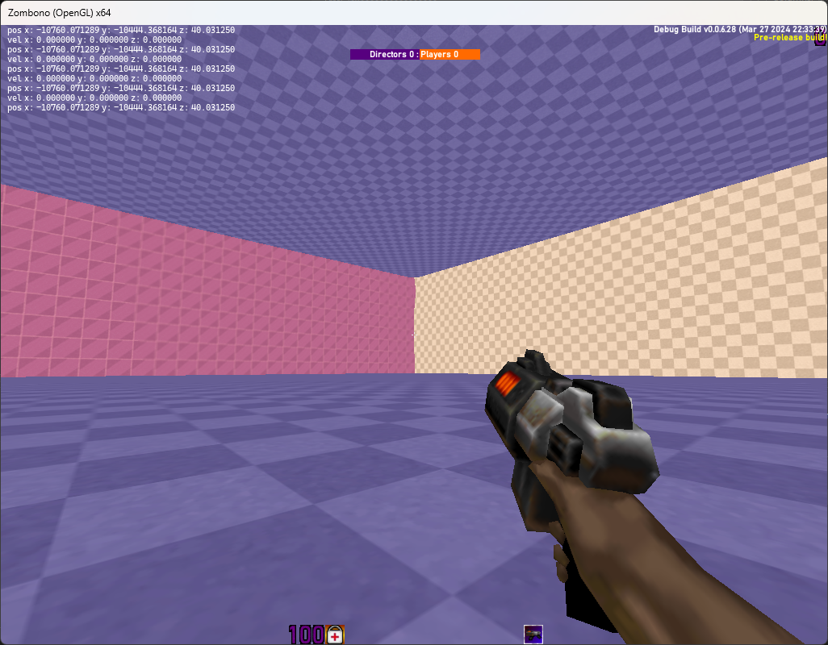
A big map (for illustrative purposes)

Slide 10
Now for the actual game…
Best to play it to demo what it is

